Slide 1
Signs with smart connectivity for better road safety
IBM PROJECT PPT
Team Id : PNT2022TMID18923
Submitted by
Hariharan R(Team lead)
Harishankar T
Jaganraj R
Jananisri S

Slide 2
Content:
Introduction
Literature survey
Ideation and proposed solution
Requirement analysis
Project design
Project planning and scheduling
Coding and solution
Testing
Advantages and disadvantages
Future scope
conclusion
PNT2022TMID18923

Slide 3
Introduction
To replace the static signboards, smart connected signboards are used.
These smart connected sign boards get the speed limitations from a web app using weather API and update automatically.
Based on the weather changes the speed may increase or decrease.
Based on the traffic and fatal situations the diversion signs are displayed.
Guide (Schools), Warning and Service (Hospitals, Restaurants) signs are also displayed accordingly.
Different modes of operations can be selected with the help of buttons.
Smart Traffic Management is a system to monitor and control traffic signals using sensors to regulate the flow of traffic and to avoid congestion for a smooth flow of traffic.
Prioritizing traffic like ambulances, police etc. is also one application comes under smart traffic management.
PNT2022TMID18923

Slide 4
Literature Survey
Analysis of crash data has suggested a link between roadside advertising signs and safety.
Research suggests that crash risk increases by approXimate 25–29% in the presence of digital roadside advertising signs compared to control areas.
On the other hand, static roadside advertising signs have not been linked with differences in the crash count.
However, this finding is contrary to previous research that suggests differences in crash counts exist in the presence of static roadside advertising.
The quantity and quality of available evidence limit our conclusion.
Fixed object, side swipe and rear end crashes are the most common types of crashes in the presence of roadside advertising signs.
PROBLEM STATEMENT : This project will replace the static boards to smart signed boards that will change the speed limits according to the weather climate and show diversion messages if there are accidents in the road and alert messages if there is hospital, schools or any road works.
PNT2022TMID18923

Slide 5
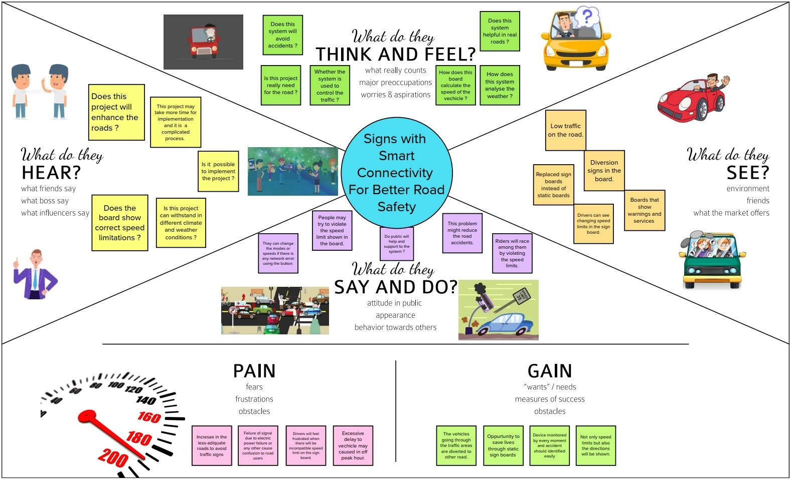
Ideation and proposed solution
Empathy map
PNT2022TMID18923

Slide 6
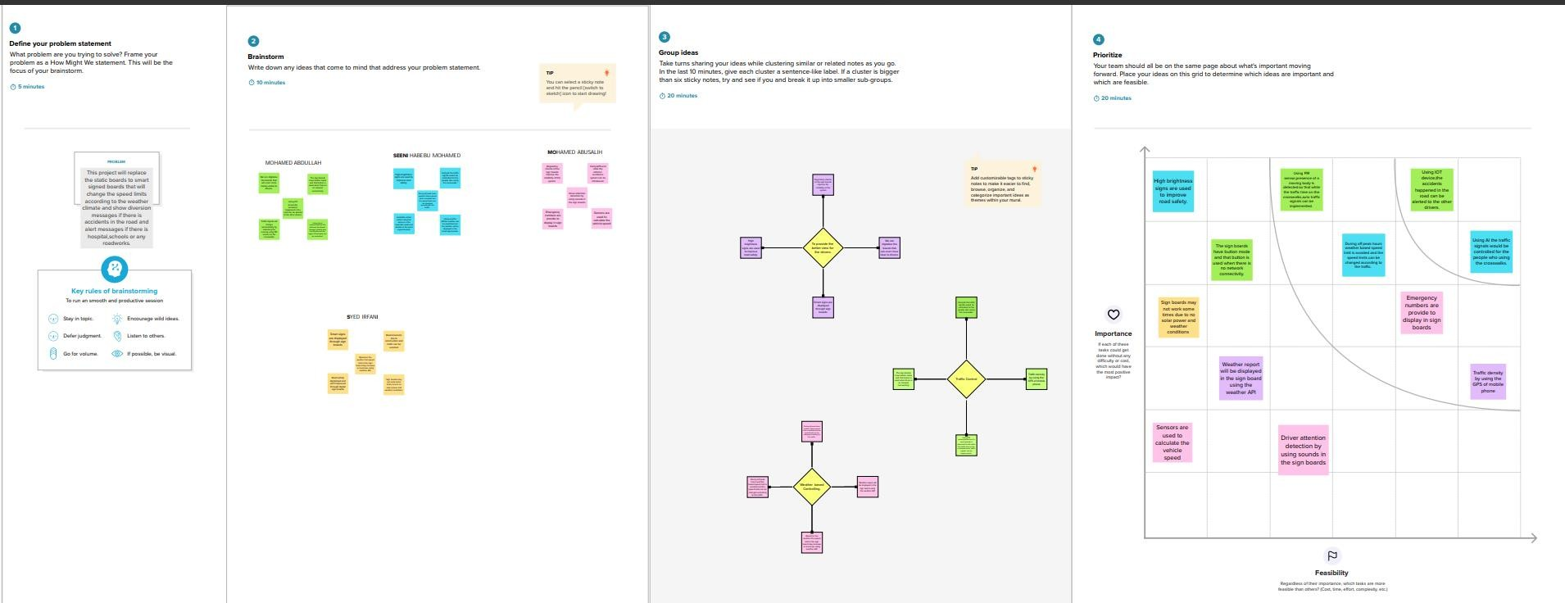
Ideation and brainstorming
PNT2022TMID18923

Slide 7
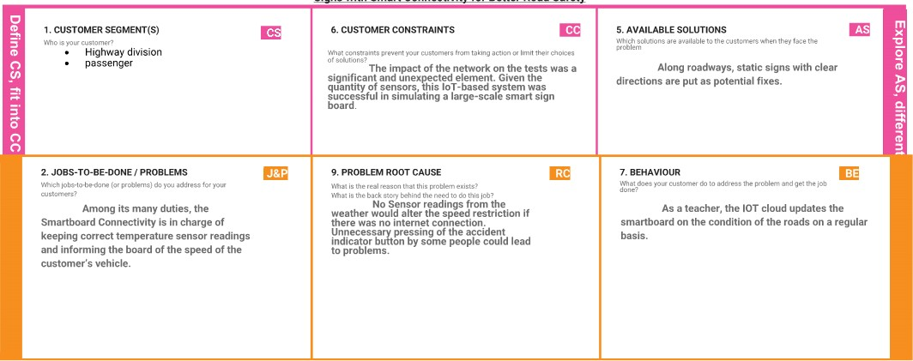
Problem solution fit
PNT2022TMID18923

Slide 8
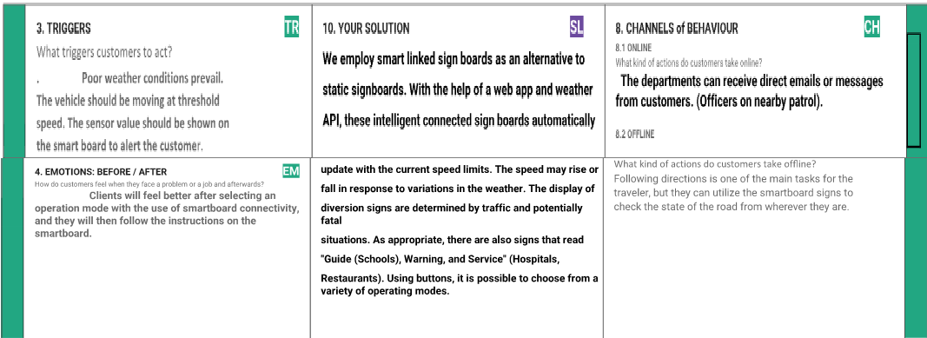
PNT2022TMID18923

Slide 9
Requirement analysis
FR-I
User Visibility
Sign Boards should be made of bright colored LEDs capable of attracting driver's attention Not too distracting to cause accidents
FR-2
User Understanding
Should display information through means like images/illustrations with text so that the user can understand the signs correctly
FR-3
User Convenience
Display should be big enough to display all the signs correctly so that it is visible even to far away drivers
PNT2022TMID18923

Slide 10
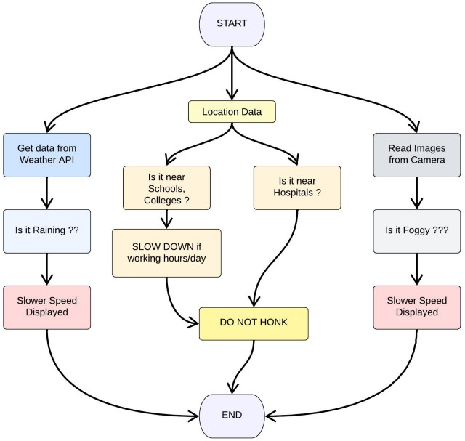
Project design
PNT2022TMID18923

Slide 11
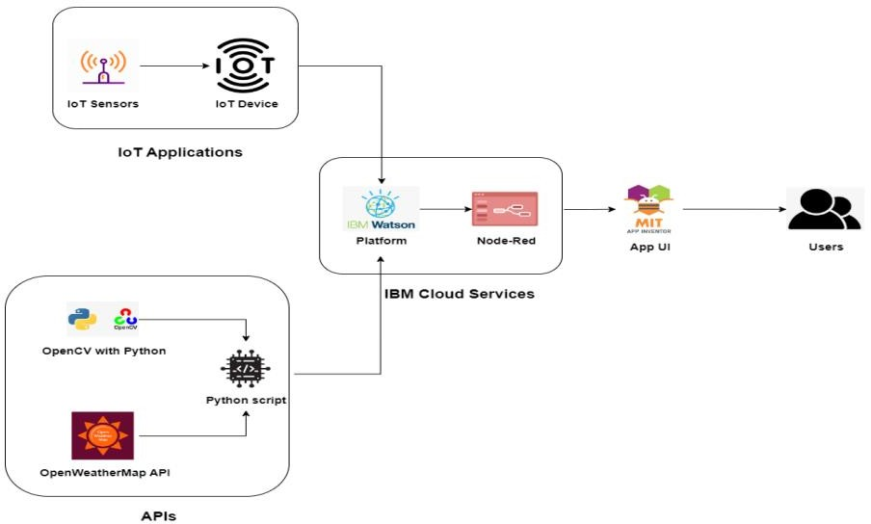
Solution and technical architecture
PNT2022TMID18923

Slide 12
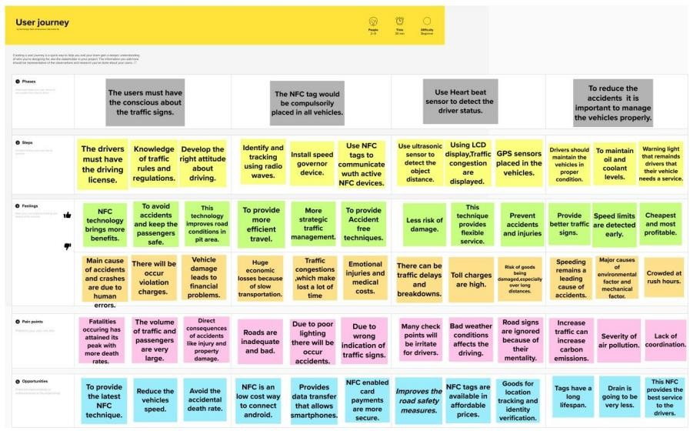
User stories
PNT2022TMID18923

Slide 13
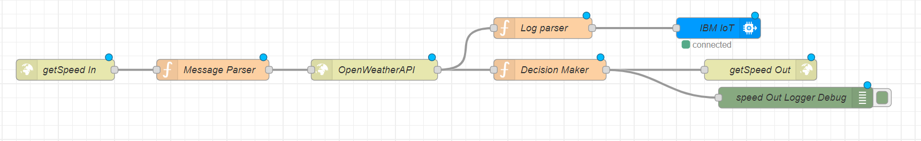
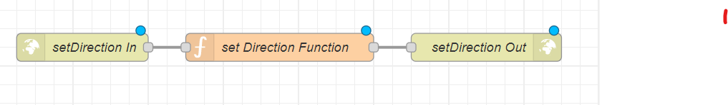
Coding and solutioning
PNT2022TMID18923

Slide 14
This part of Node RED flow accepts an http GET end point at "/get Speed" from which the location, uid, hospital/school zone info are passed.
Message parser sets the required APIKEY for Open Weather API
for the next block.
This data is then passed onto Decision Maker which makes all the decisions regarding the message to be output at the display and sends it as a http response.
This data is displayed at the microcontroller. Thus, a lot of battery is saved due to lesser processing time.
This part of Node RED flow accepts an http GET end point at "/setDirection" from which the uid and direction information are passed by the respective authorities. Set Direction Function block adds the direction information to the database and returns the same as an http response. This data is sent to the microcontroller along with the "/getSpeed" path and the microcontroller displays it.
PNT2022TMID18923

Slide 15
Testing
Test Cases
TEST CASE 1
Clear weather - Usual Speed Limit.
TEST CASE 2
Foggy Weather - Reduced Speed Limit.
TEST CASE 3
Rainy Weather - Further Reduced Speed Limit.
TEST CASE 4
School/Hospital Zone - Do not Honk sign is displayed.
PNT2022TMID18923

Slide 16
User Acceptance Testing
Dynamic speed & diversion variations based on the weather and traffic helps user to avoid traffic and have a safe journey home.
The users would welcome this idea to be implemented everywhere.
PNT2022TMID18923

Slide 17
Performance Metrics
Based on the IBM pack we chose, the performance of the website varies. Built upon NodeJS, a light and high performance engine, Node RED is capable of handling up to 10,000 requests per second.
Moreover, since the system is horizontally scalable, an even higher demand of customers can be served.
PNT2022TMID18923

Slide 18
ADVANTAGES
Lower battery consumption since processing is done mostly by Node RED servers in the cloud.
Cheaper and low requirement micro controllers can be used since processing requirements are reduced.
Longer lasting systems.
Dynamic Sign updating.
School/Hospital Zone alerts
PNT2022TMID18923

Slide 19
DISADAVNTAGES
The size of the display determines the requirement of the micro controller
Dependent on Open Weather Map API and hence the speed reduction is same for a large area in the scale of cities.
PNT2022TMID18923

Slide 20
Future scope
Introduction of intelligent road sign groups in real life scenarios could have great impact on increasing the driving safety by providing the end-user (car driver) with the most accurate information regarding the current road and traffic conditions. Even displaying the information of a suggested driving speed and road surface condition (temperature, icy, wet or dry surface) could result in smoother traffic flows and, what is more important, in increasing a driver’s awareness of the road situation.
PNT2022TMID18923

Slide 21
Conclusion
Our project is capable of serving as a replacement for static signs for a comparatively lower cost and can be implemented in the very near future.
This will help reduce a lot of accidents and maintain a more peaceful traffic atmosphere in the country.
PNT2022TMID18923

